Slide 1


SOFTWARE TESTING
NAME: LAKSHMANAN M
DEPARTMENT: QA

Slide 2
OBJECTIVES
SOFTWARE TESTING LIFE CYCLE
HOW TO SELECT TESTING TOOLS
AUTOMATION TESTING TOOLS
TEST PLANNING
TEST EXECUTION & REPORTING
TEST DOCUMENTS
TEST APPROACH

Slide 3
SOFTWARE TESTING LIFE CYCLE
REQUIREMENT UNDERSTANDING
TEST PLAN (DEFINE OBJECTIVE, ESTIMATION, DEADLINE..)
TEST DESIGN (TEST CASE DOCUMENT,….)
TEST ENVIRONMENT (QC)
TEST EXECUTION
DEFECT TRACKING
TEST CLOSURE

Slide 4
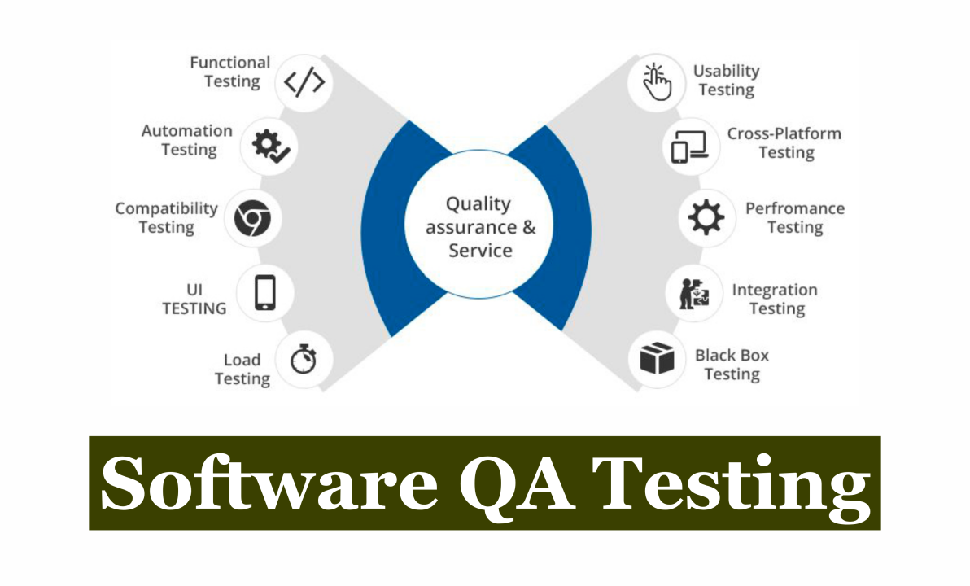

Slide 5
HOW TO SELECT TESTING TOOLS
IS THE TOOL EASY TO LEARN AND USE?
DOES ITS FEATURE SETS COVER ESSENTIAL MOBILE/WEB-SPECIFIC TESTING TASKS?
ARE INTEGRATIONS WITH CI/CD SYSTEMS OR OTHER PLATFORMS NATIVE?
DOES THE TOOL PROVIDE SCRIPTING AND SCRIPT LESS METHODS?
IS THE TOOL SUITABLE FOR YOUR BUDGET AND AUT?

Slide 6
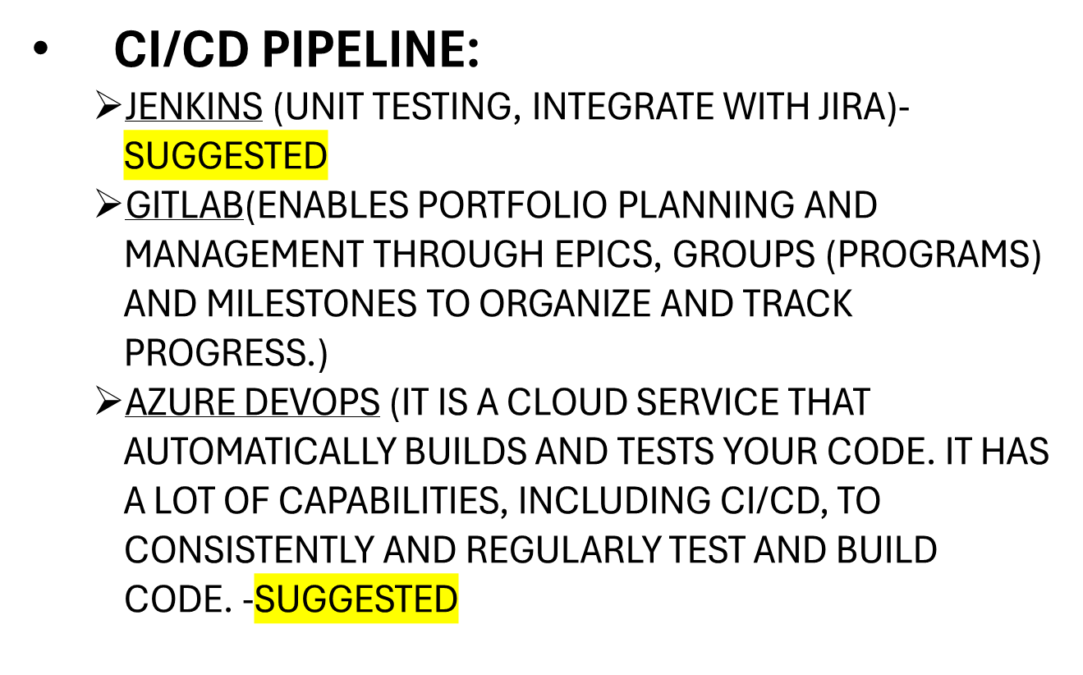
AUTOMATION TESTING
Notes:
Since exhaustive black box testing is generally impossible, these test should be viewed as statistical sampling; when errors are found, a closer examination is required. Functional testing stars by examining the functions the program is to perform and devising a sequence of inputs to test them.

Slide 7
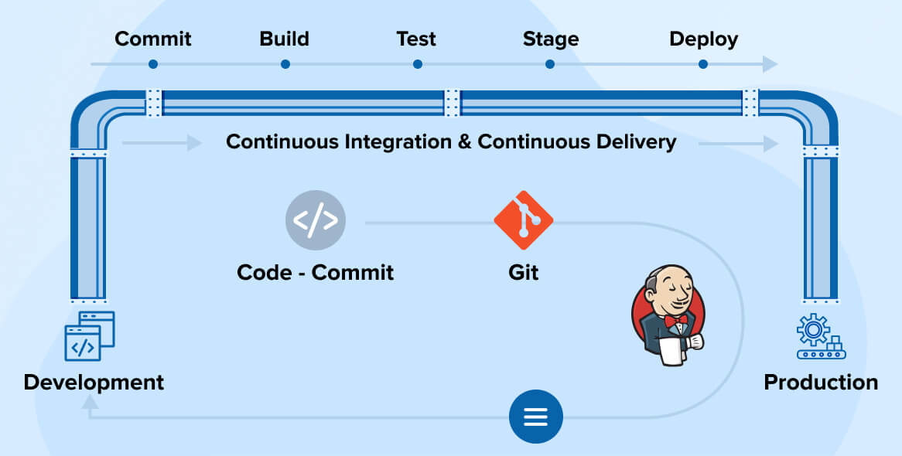
CI/CD PIPELINE:

Slide 8
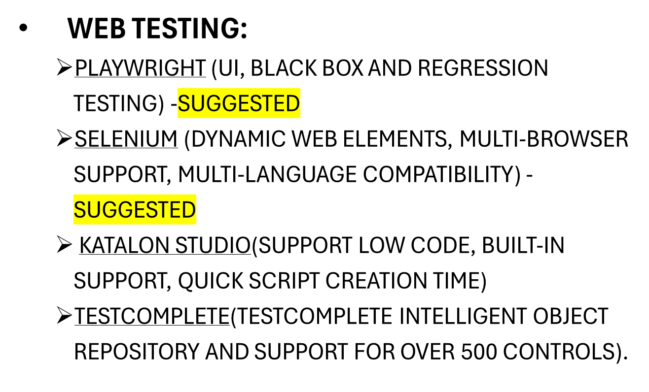
Notes:
Since exhaustive black box testing is generally impossible, these test should be viewed as statistical sampling; when errors are found, a closer examination is required. Functional testing stars by examining the functions the program is to perform and devising a sequence of inputs to test them.

Slide 9
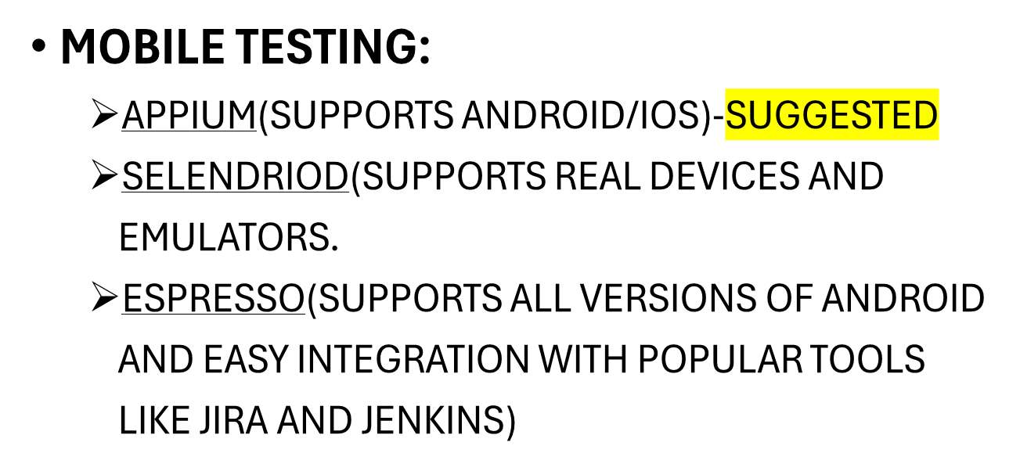
Notes:
Since exhaustive black box testing is generally impossible, these test should be viewed as statistical sampling; when errors are found, a closer examination is required. Functional testing stars by examining the functions the program is to perform and devising a sequence of inputs to test them.

Slide 10
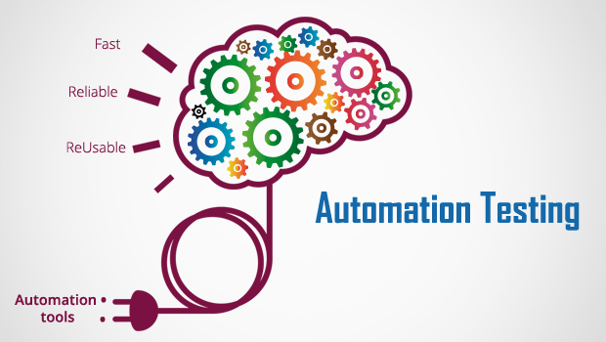

Slide 11
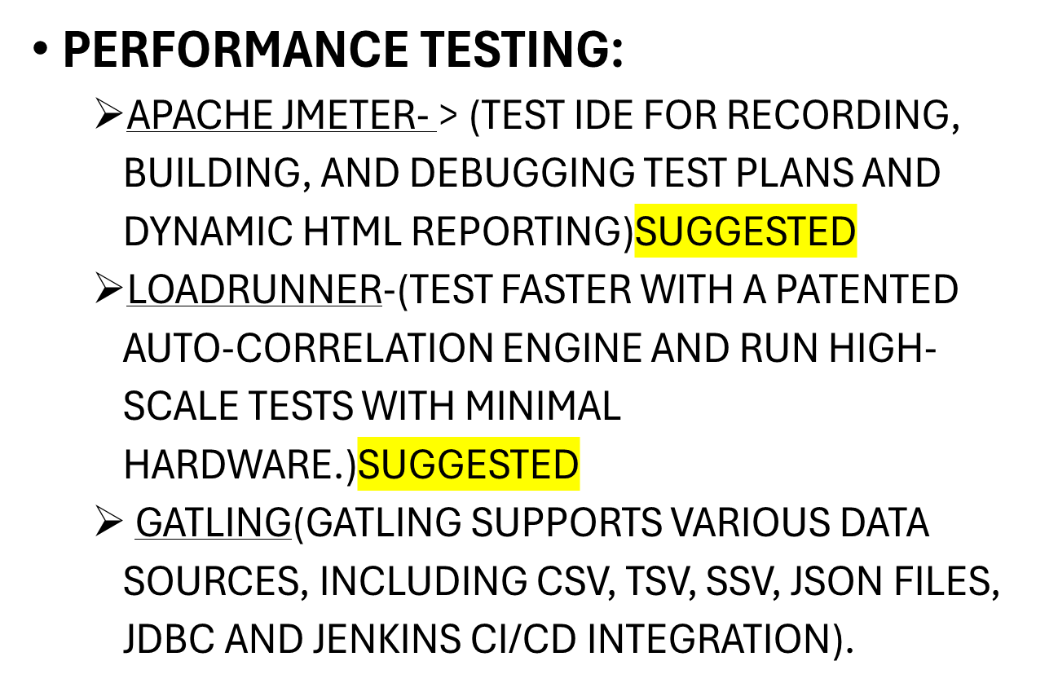
Notes:
Since exhaustive black box testing is generally impossible, these test should be viewed as statistical sampling; when errors are found, a closer examination is required. Functional testing stars by examining the functions the program is to perform and devising a sequence of inputs to test them.

Slide 12
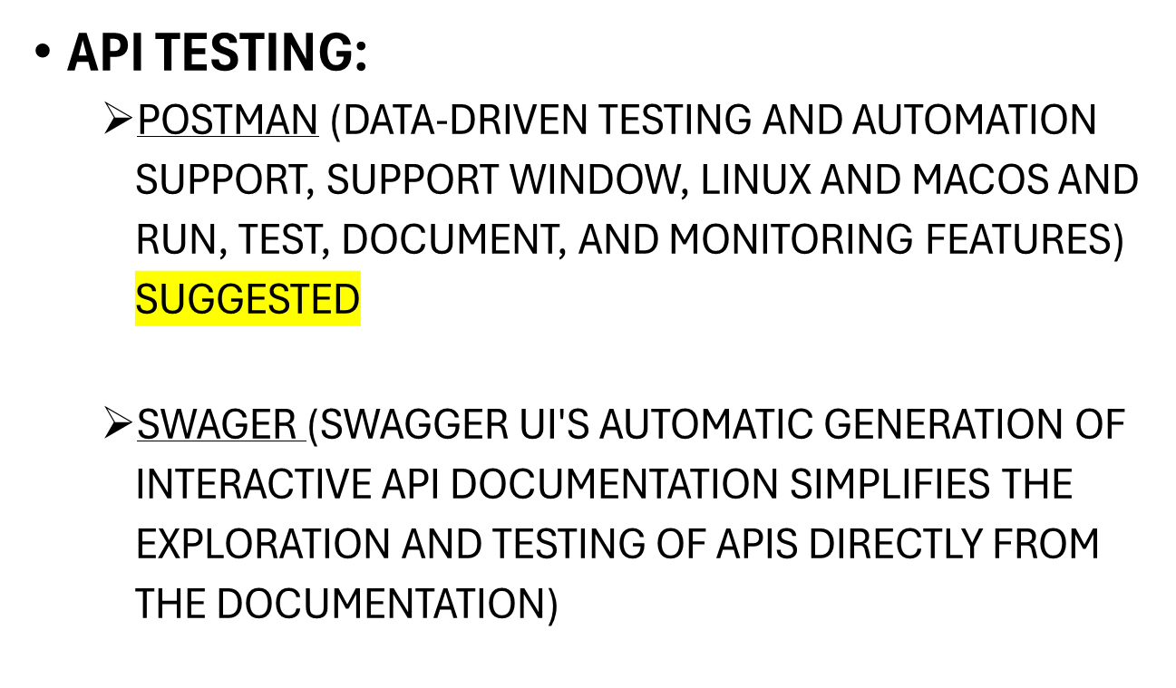
Notes:
Since exhaustive black box testing is generally impossible, these test should be viewed as statistical sampling; when errors are found, a closer examination is required. Functional testing stars by examining the functions the program is to perform and devising a sequence of inputs to test them.

Slide 13
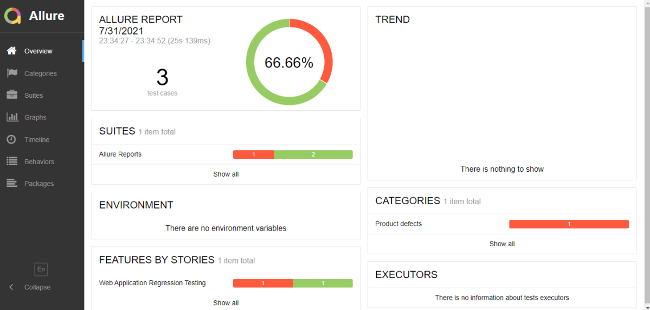
REPORTS:
  ALLURE REPORT
  EXTEND REPORT
  TESTNG
Notes:
Since exhaustive black box testing is generally impossible, these test should be viewed as statistical sampling; when errors are found, a closer examination is required. Functional testing stars by examining the functions the program is to perform and devising a sequence of inputs to test them.

Slide 14
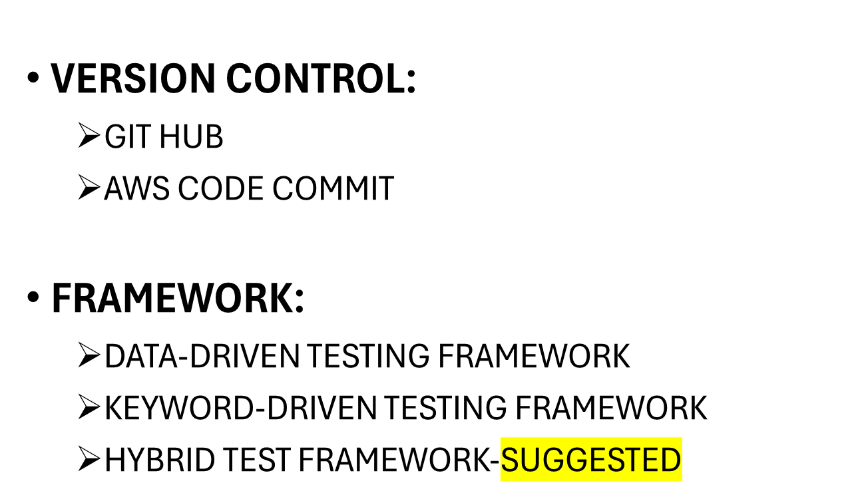
Notes:
Since exhaustive black box testing is generally impossible, these test should be viewed as statistical sampling; when errors are found, a closer examination is required. Functional testing stars by examining the functions the program is to perform and devising a sequence of inputs to test them.

Slide 15
COMMON FILES:
  SVN
  FTP
  ONEDRIVE
IDE:
  VISUAL STUDIO
  ECLIPSE
  INTELLIJ
Notes:
Since exhaustive black box testing is generally impossible, these test should be viewed as statistical sampling; when errors are found, a closer examination is required. Functional testing stars by examining the functions the program is to perform and devising a sequence of inputs to test them.

Slide 16
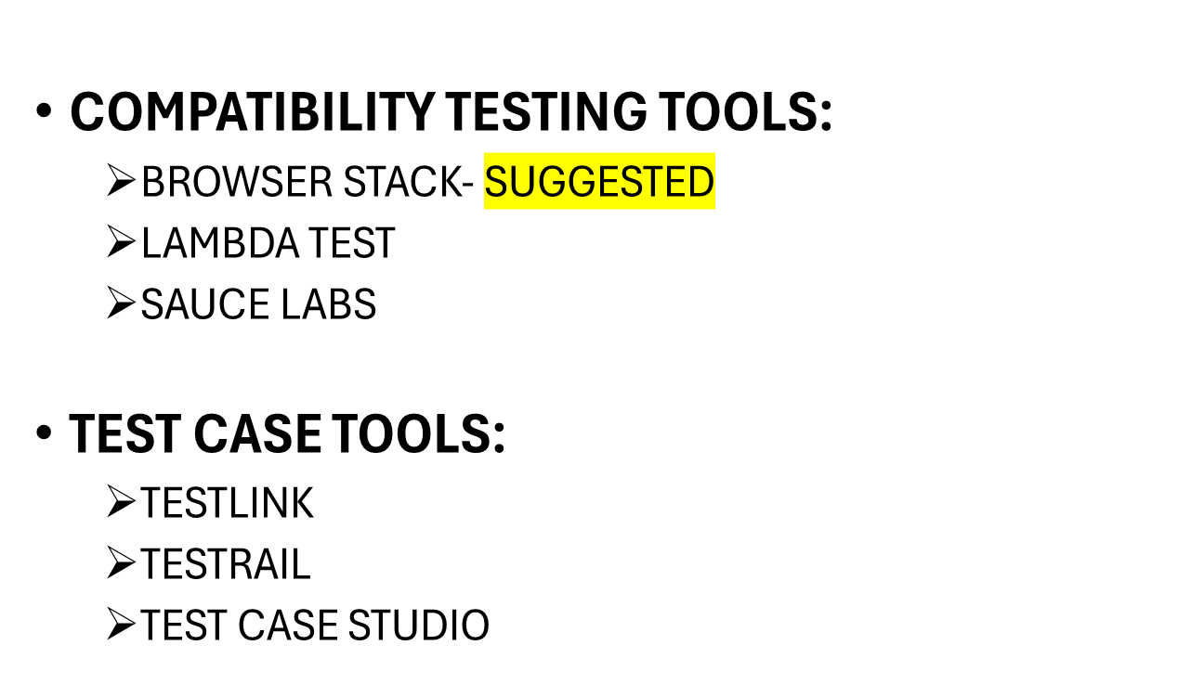
Notes:
Since exhaustive black box testing is generally impossible, these test should be viewed as statistical sampling; when errors are found, a closer examination is required. Functional testing stars by examining the functions the program is to perform and devising a sequence of inputs to test them.

Slide 17
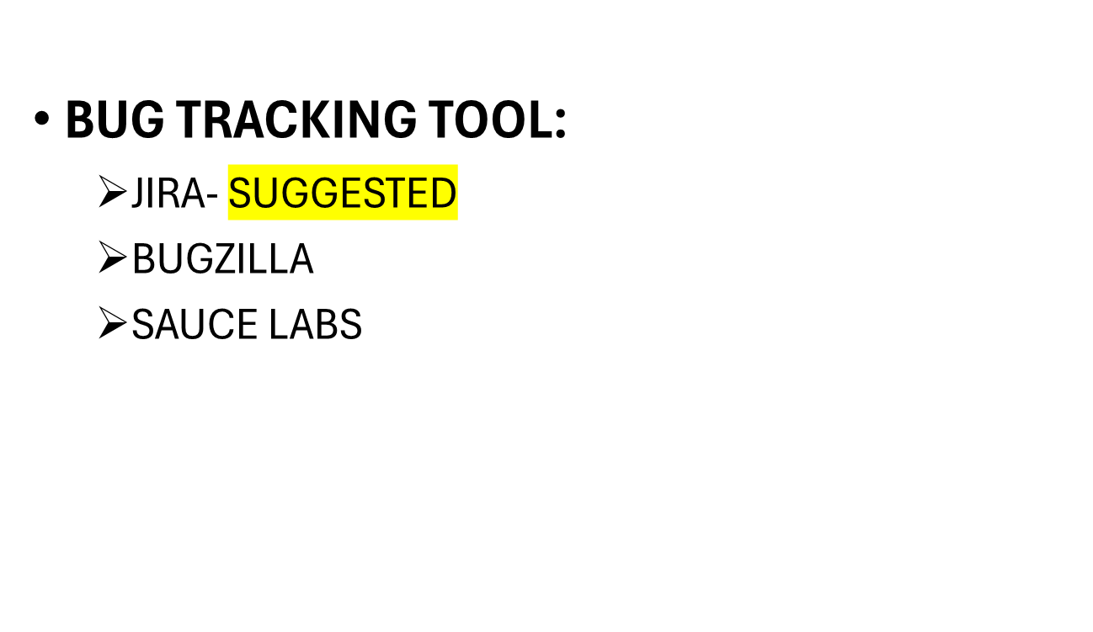
Notes:
Since exhaustive black box testing is generally impossible, these test should be viewed as statistical sampling; when errors are found, a closer examination is required. Functional testing stars by examining the functions the program is to perform and devising a sequence of inputs to test them.

Slide 18
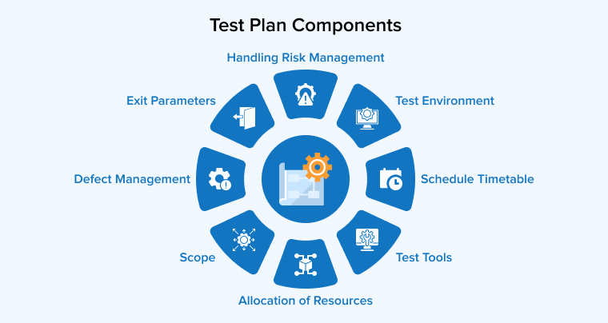
TEST PLANNING
Notes:
Generally speaking, it is too late to begin test planning when testing actually begins. A test planning can uncover at least as many problems as the actual tests themselves.
Test planning starts with an overall development plan that defines the functions, roles and methods for all test phases. Some items needed for a good test plan must come from the requirement phase and they must be tracked throughout development. So, it would be better to conduct an early requirements inspection or walkthrough and to hold a re-review after every major changes.

Slide 19
TEST EXECUTION & REPORTING
TESTING SHOULD BE TREATED LIKE AN EXPERIMENT.
TESTING REQUIRE THAT ALL ANOMALOUS BEHAVIOR BE NOTED AND INVESTIGATED.
BIG COMPANIES KEEP A SPECIAL LIBRARY WITH ALL COPIES OF TEST REPORTS, INCIDENT FORMS, AND TEST PLANS
Notes:
Everything test should be treated like an experiment toe be carefully controlled and recorded so that it can be reproduced.
The experimental approach also requires meticulous care in defining and recording the test environment., the procedures,and the test cases. Many organizations have found it valuable to keep a special test library with all copies of such material, together with test reports, incident forms, test analyses, and test plans.

Slide 20
TEST EXECUTION & REPORTING
UI TESTING:
  ONCE THE UI DESIGNING COMPLETE FROM DEV TEAM, LETS START THE UI TESTING
  VERIFY THE UI LOOK & FEEL AND CHECK THE UI LOOKING USER FRIENDLY, USER CAN EASILY ACCESS THE PAGE(FIELDS, BUTTON, LINKS AND CHECK BOXES)
Notes:
Everything test should be treated like an experiment toe be carefully controlled and recorded so that it can be reproduced.
The experimental approach also requires meticulous care in defining and recording the test environment., the procedures,and the test cases. Many organizations have found it valuable to keep a special test library with all copies of such material, together with test reports, incident forms, test analyses, and test plans.

Slide 21
EARLY TESTING :
  TESTING START TO EARLIER, FIND ANY BUGS WHILE PERFORM EARLY TESTING, DEVELOPER CAN FIX THE ISSUE EASILY, WHICH IS REDUCE THE COST OF DEVELOP AND TESTING
ACCESSIBILITY TESTING:
  ACCESSIBILITY TESTING PROCESS THAT EVALUATES A PRODUCT'S USABILITY FOR ALL USERS, INCLUDING THOSE WITH DISABILITIES, TO ENSURE IT MEETS ACCESSIBILITY STANDARDS AND LAWS .
Notes:
Everything test should be treated like an experiment toe be carefully controlled and recorded so that it can be reproduced.
The experimental approach also requires meticulous care in defining and recording the test environment., the procedures,and the test cases. Many organizations have found it valuable to keep a special test library with all copies of such material, together with test reports, incident forms, test analyses, and test plans.

Slide 22
SMOKE TESTING:
  IT IS TYPE OF TESTING, ENSURE THE CRITICAL FUNCTIONALITY AND MAJOR IS WORKING FINE OR NOT.
  IF THE SMOKE TEST IS PASS, TESTER CAN CONTINUE THE FURTHER TESTING, IF IT IS FAIL, TESTER DIRECTLY STOP THE TESTING AND COMMUNICATE TO THE DEVELOPING TEAM
Notes:
Everything test should be treated like an experiment toe be carefully controlled and recorded so that it can be reproduced.
The experimental approach also requires meticulous care in defining and recording the test environment., the procedures,and the test cases. Many organizations have found it valuable to keep a special test library with all copies of such material, together with test reports, incident forms, test analyses, and test plans.

Slide 23
ITERATION-1 TESTING:
  IN THIS PHASE WE JUST EXECUTE THE TEST CASE AND CHECK THE ALL FUNCTIONALITY AND FEATURES WORKING FINE OR NOT.
  VERIFY THE FIELD VALIDATION, UI VALIDATION, DATA FLOW, IMPACTS AND END TO END SCENARIO FOR MODULE OR PROJECT.
Notes:
Everything test should be treated like an experiment toe be carefully controlled and recorded so that it can be reproduced.
The experimental approach also requires meticulous care in defining and recording the test environment., the procedures,and the test cases. Many organizations have found it valuable to keep a special test library with all copies of such material, together with test reports, incident forms, test analyses, and test plans.

Slide 24
PREPARE TEST METRICS:
  PREPARE BUG REPORT
  PREPARE TEST CASE REPORT
  PREPARE TEST SUMMARY REPORT
BUG VERIFICATION:
  VERIFY THE ALL RELEASED BUGS WORKING FINE OR NOT,
  CHECK THE GIVEN BUG SCENARIO AND IMPACT SCENARIO
Notes:
Everything test should be treated like an experiment toe be carefully controlled and recorded so that it can be reproduced.
The experimental approach also requires meticulous care in defining and recording the test environment., the procedures,and the test cases. Many organizations have found it valuable to keep a special test library with all copies of such material, together with test reports, incident forms, test analyses, and test plans.

Slide 25
ITERATION-2 TESTING:
  WHEN TESTER FEEL THAT PARTICULAR MODULE OR BUILD HAVE LOTS OF BUGS, THEN START ITERATION-2 TESTING.
CLOSURE TESTING:
  PERFORM FULL ROUND TESTING, ENSURE THE MODULE WORKING FINE BASED ON THE CUSTOMER NEEDS AND EXPECTATION.
  ENSURE THE BUILD IS READY TO MOVE THE UAT ENVIRONMENT.
Notes:
Everything test should be treated like an experiment toe be carefully controlled and recorded so that it can be reproduced.
The experimental approach also requires meticulous care in defining and recording the test environment., the procedures,and the test cases. Many organizations have found it valuable to keep a special test library with all copies of such material, together with test reports, incident forms, test analyses, and test plans.

Slide 26
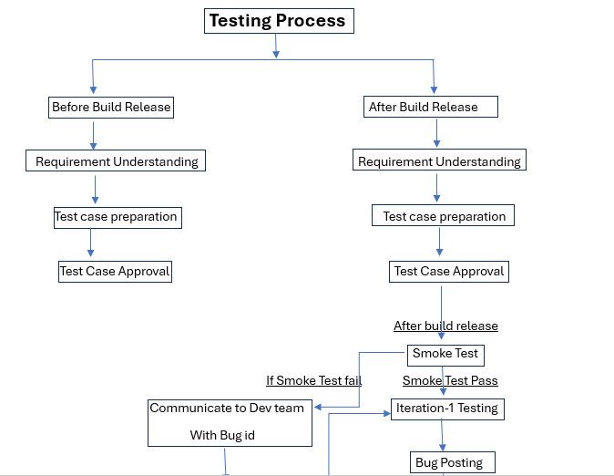

Slide 27
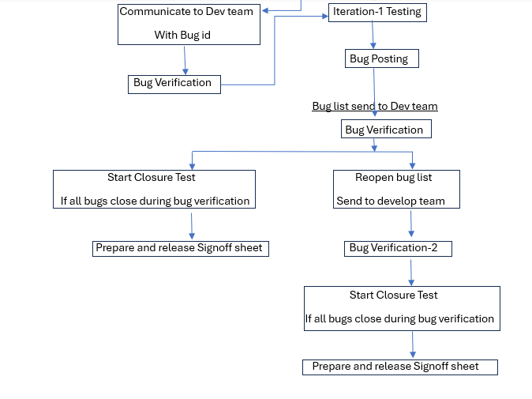

Slide 28


